Slide 1
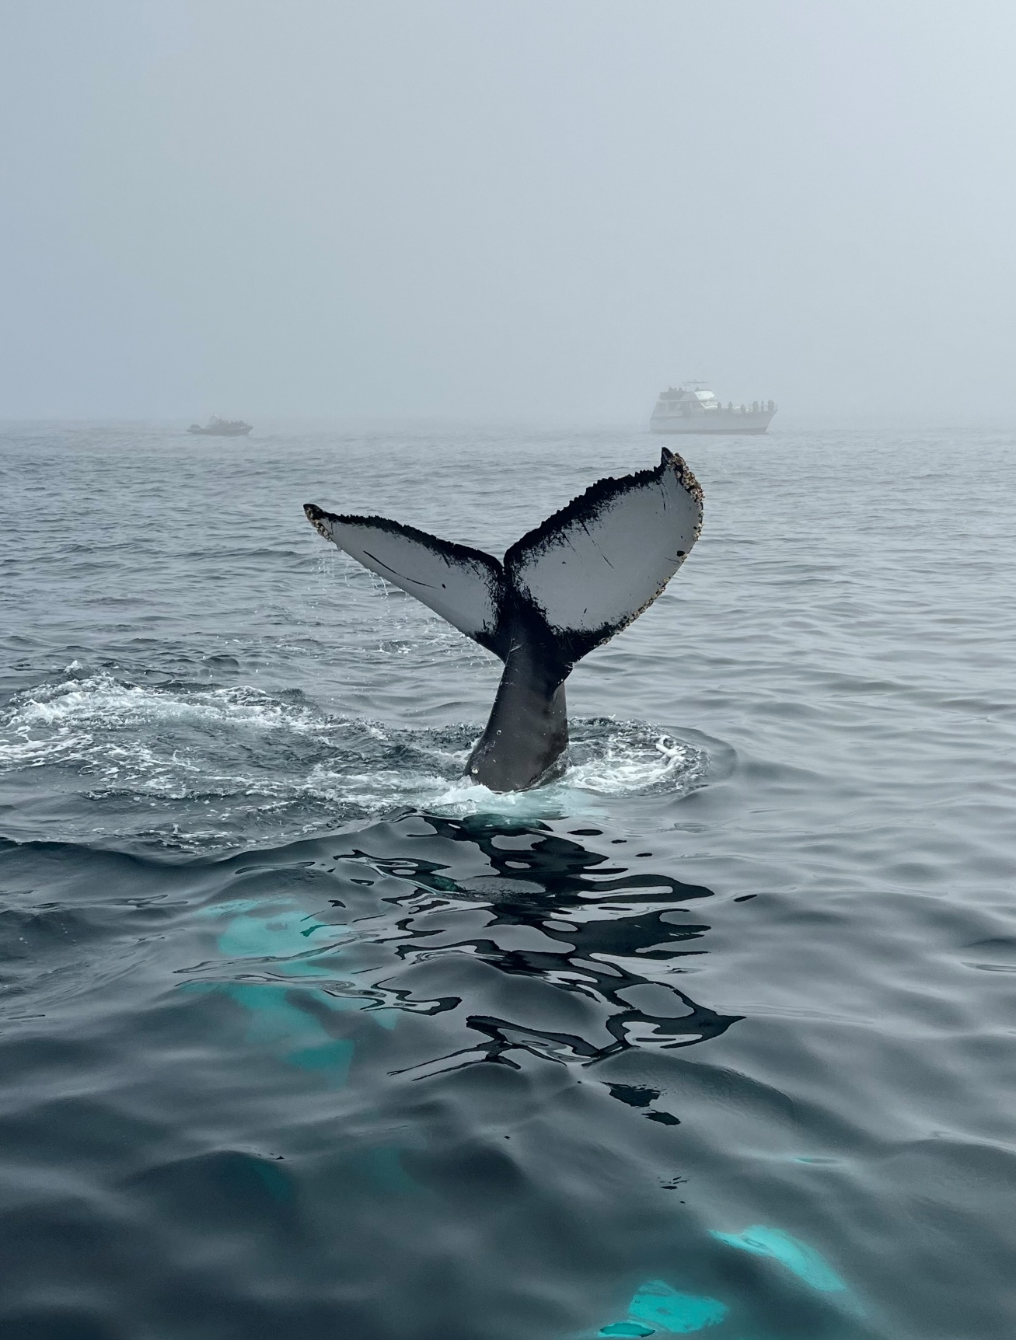


Whale Tail Grantee Orientation
Jessica Lie, Jessica.Lie@coastal.ca.gov
Annie Kohut Frankel, Annie.Frankel@coastal.ca.gov
Shelby Wayment
Notes:
Hello! Thank you all for joining this morning/afternoon.
My name is Jessica Lie and I’m the Grants and Education Program Analyst with the California Coastal Commission. I am your primary contact for your Whale Tail Grant and who you will be sending your invoices and reports to. I’m joined by my colleague, Annie Kohut Frankel (Public Education Program Manager). Annie’s name and email is also on the screen, and she will be a backup contact as needed.
We want to make this process as easy for you as possible, with the acknowledgement that government grants are by nature bureaucratic. But if you take nothing else away from this meeting, I want you to know that you can contact us at any time with questions or for help with managing your grant. Email is the best way to reach out. If you prefer, we can also arrange for a phone or video call.
This orientation is for brand new Whale Tail Grants. While some of you might have had Whale Tail Grants before, there are some important differences with this cycle of grants versus previous years. One of those big differences is that the Ocean Protection Council is generously funding this grant cycle. We’ll get more into funding credit later in this presentation.

Slide 2
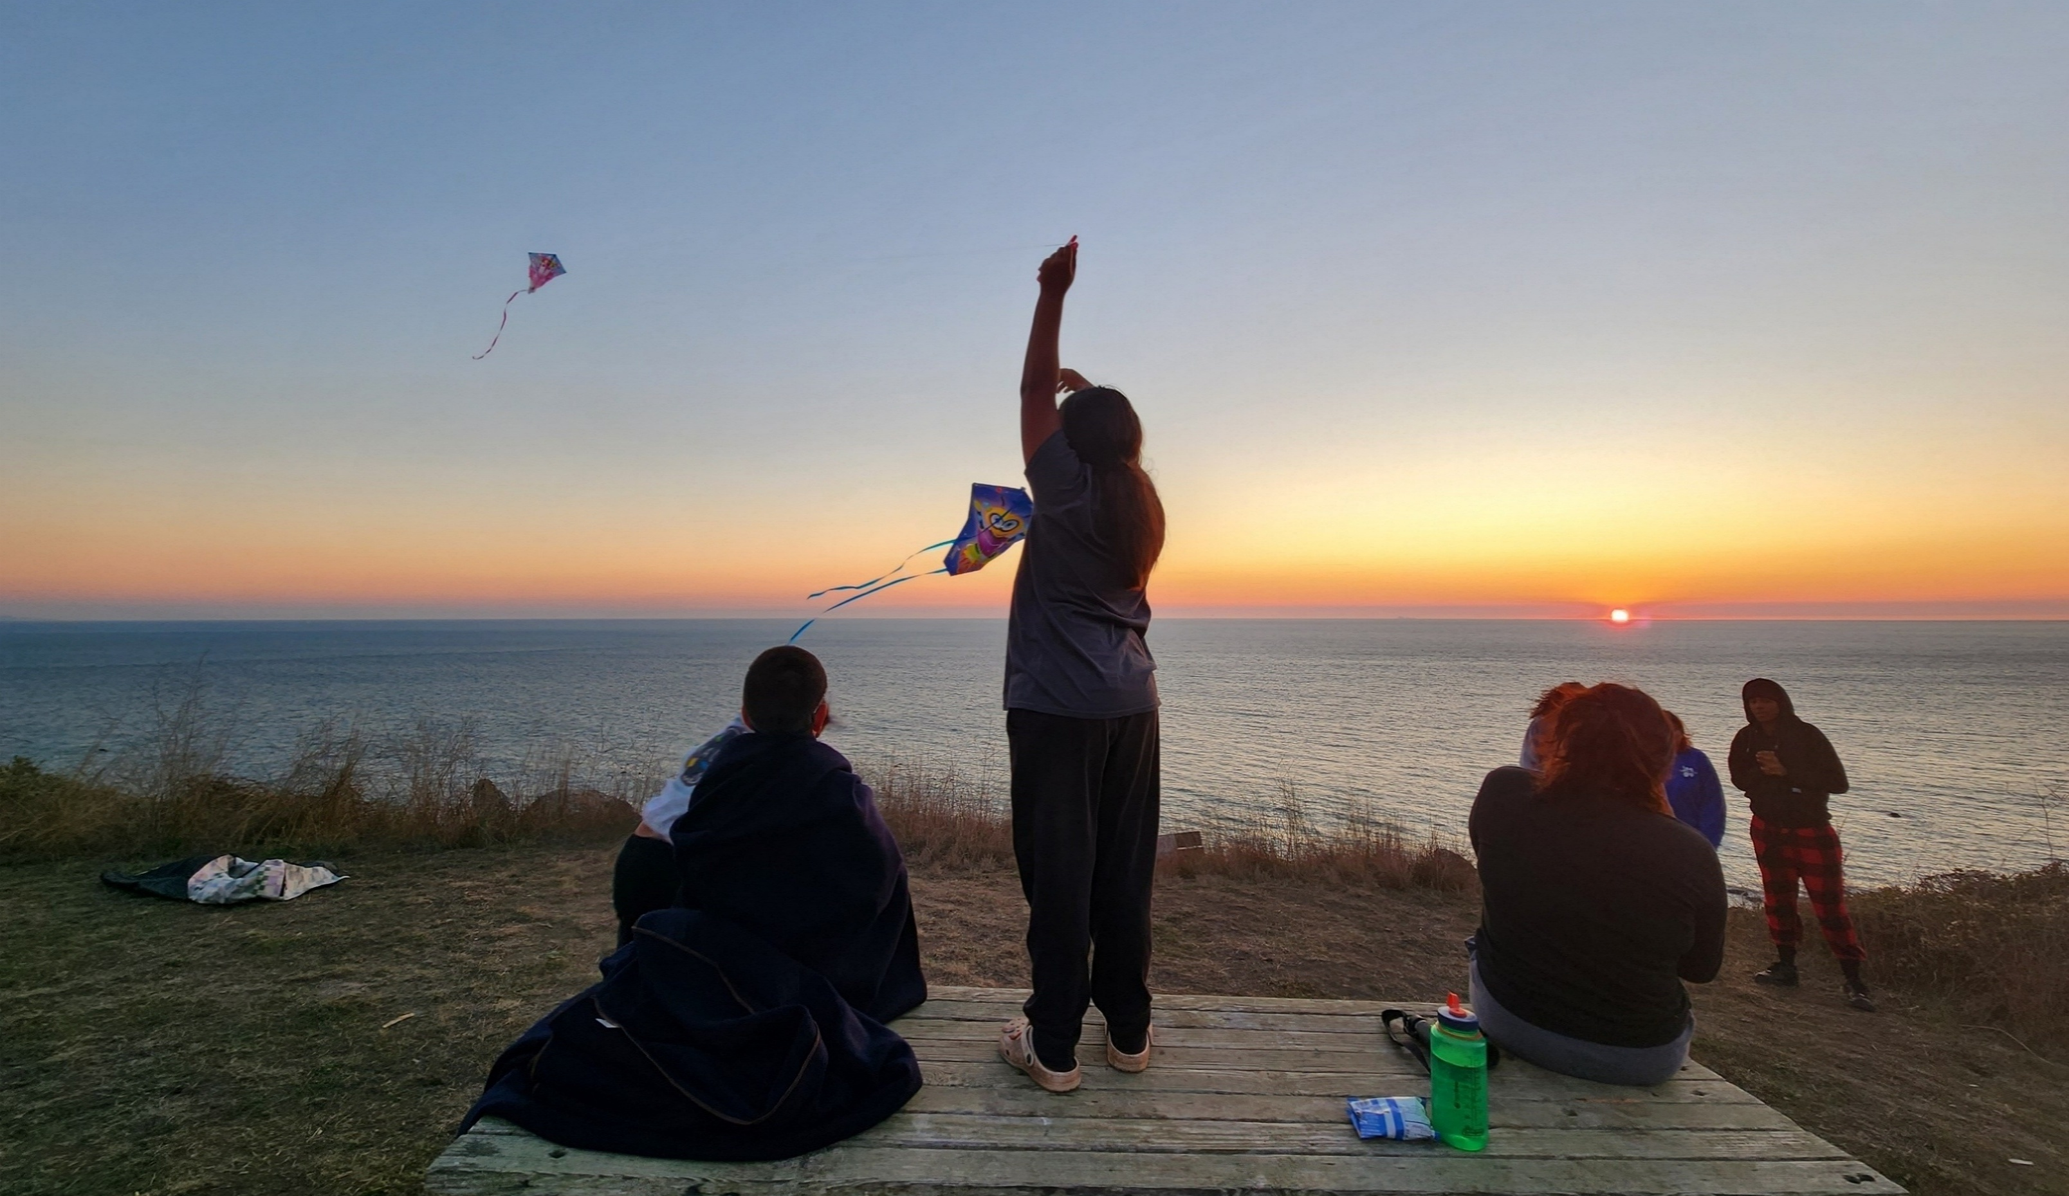
Congratulations!
Project Avary
Notes:
So first off, congratulations on receiving a Whale Tail Grant! We’re super excited to support all of you and the important work you’re doing through these projects.

Slide 3
Grant Agreement
Invoices &
Advance
Payments
Reports
Funding
Credit
Project
Delivery
Notes:
I’m going to go through the main processes and administrative responsibilities of your Whale Tail Grant. We’ll start with the grant agreement.

Slide 4
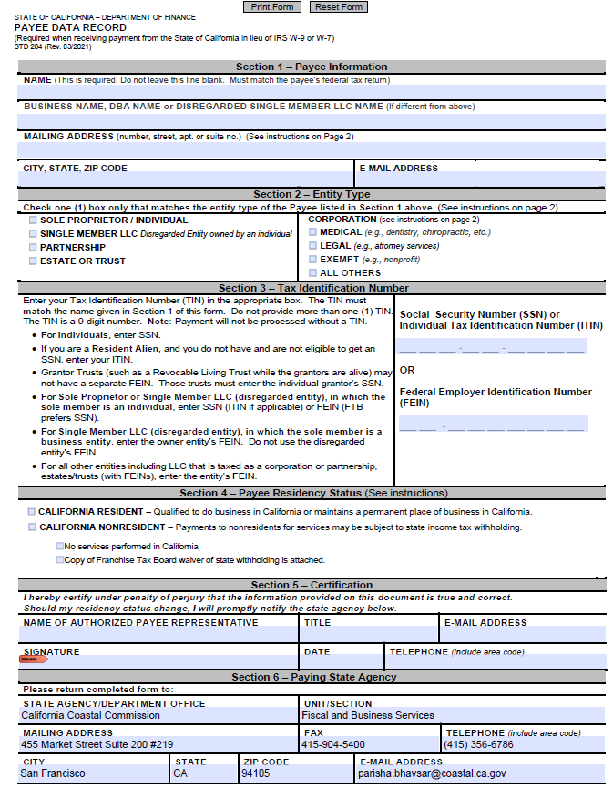
Payee Data Record Form
The organization name and address on this form should be the Grantee’s official name and address, which will be where checks are mailed to
Notes:
For grantees who already have signed grant agreements, you will already have done some of the next slides. After you send me your completed info collection sheet that I emailed out in April, I use that information along with language from your proposal to draft your grant agreement. When I send you your draft grant agreement to review, you will also receive a STD 204 Form or a Payee Data Record Form to complete and sign. The organization name and address on this form should be the Grantee’s official name and address, which will be where checks are mailed to.

Slide 5
Payee Data Record Form
“Name” refers to the organization name.
Leave this second row blank if your organization does not do business by another name.
Notes:
Let’s take a closer look at this form to go over some common confusion points.
The “NAME” field refers to the organization’s name. Please do not enter a person’s name into this first row.
For this second row, please leave it blank if your organization does not do business by another name.
Also be sure to check a box under Section 2 – Entity Type, which would be “EXEMPT”. I’m sorry that these state forms can be so confusing!

Slide 6
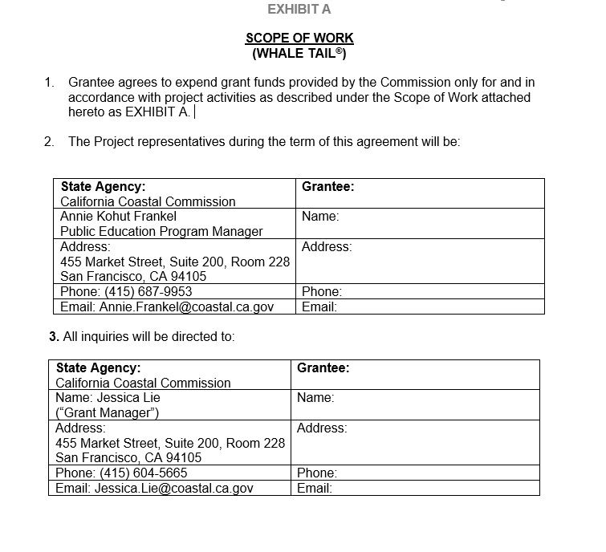
Grant Agreement
Notes:
You may not yet have a signed agreement if your project hasn’t started, so here’s a sneak peek. You should refer to the grant agreement as you implement your project – this is the contract between your organization and the Coastal Commission. Your grant application is not the contract.
The second page in your agreement has contact information. It looks like this with your info on the right side.

Slide 7
Grant Agreement
Top contact signs the agreement
Checks are sent to the top address (should match Payee Data form)
Ongoing grant communication is emailed to the bottom contact
If this contact changes, tell me
It’s OK if a different person submits invoices
Notes:
The name in the top box is the person who signs your grant agreement, and that’s pretty much the only time we need to contact them, unless they’re also the contact in the bottom box.
The top address is the official grant recipient organization and the address where checks will be mailed. This address should match the one in the Payee Data Record form we looked at before.
The bottom box should be our main contact person, the one who we send reminders and announcements to. If you’re fiscally sponsored, the bottom Grantee name may be different than the one above. We have mailing addresses in both boxes, but aside from mailing checks you’re unlikely to get anything in your mailbox from us. Pretty much everything else is conducted by email.
If the main contact person for your grant changes, please send me an email to let me know. We don’t have to do an amendment for that, but we need to make sure that when we send an email to your organization there’s someone opening it. And it’s fine if you have yet a different person sending me your invoices.

Slide 8
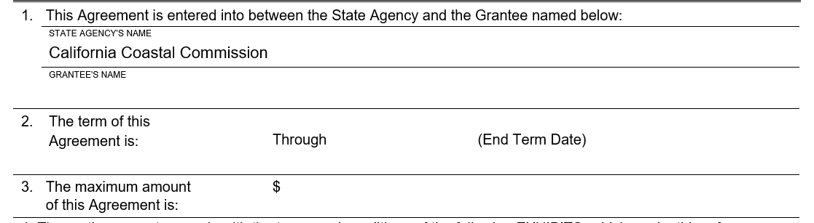
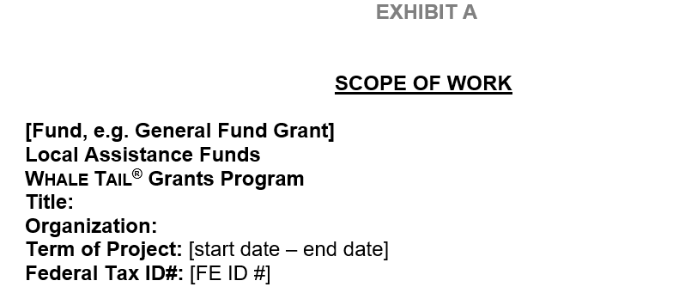
1st page of grant agreement
Grant Agreement
We can only reimburse expenses that occur within your Project Term.
Do not incur expenses on this grant until the project start date.
Do not incur expenses past your grant end date.
3rd page of grant agreement
Notes:
Your grant agreement will also have the Term of your Project (aka your project start date and end date) on the 1st page and the 3rd page.
We are only able to reimburse expenses that occur within these dates in your grant agreement.
If you have not started your project yet, please do not incur expenses until the project start date listed on your grant agreement.
Similarly, please be sure to not incur expenses past your grant end date.
If you need to extend your grant end date, I’ll get into the grant amendment process later in this presentation.

Slide 9
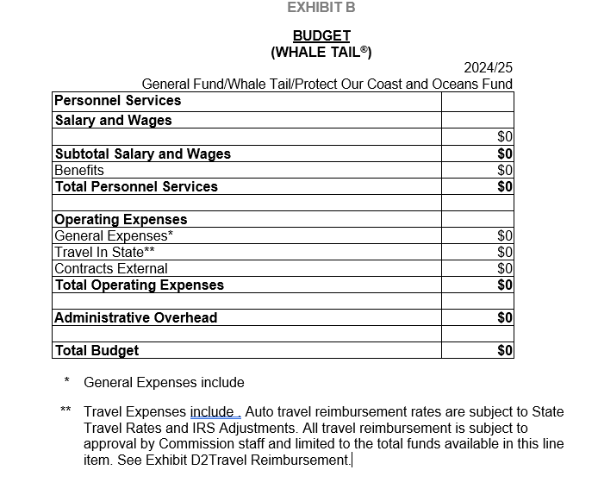
Grant Agreement
We can only reimburse what’s in your grant budget.
If you think you may need budget changes, reach out to me first.
Any changes need to be pre-approved in writing.
Notes:
Also in your agreement is your grant budget. What you see on the screen is a blank version – your grant agreement will have the line items and amounts specific to your project. This is what the Coastal Commission will be tracking as you submit your invoices. This shows what we’re allowed to reimburse you for. Anything you want to be reimbursed for should be able to be described by what’s on the budget. If you have General Expenses in your budget, there will be a list below the budget table describing what’s included in that item. If you have travel expenses in your budget, it will list what’s included in your travel.
If at any time you think you may need to make changes to the allocations in this budget, including the items that are allowed under General Expenses or travel, or if you want to make changes to any other part of the grant agreement, you need to get in touch with me first. Remember that the budget details are not a suggestion or an estimation, it’s a contract.
Approvals for changes need to be in writing. Again, I’ll talk more about amending your grant later.

Slide 10
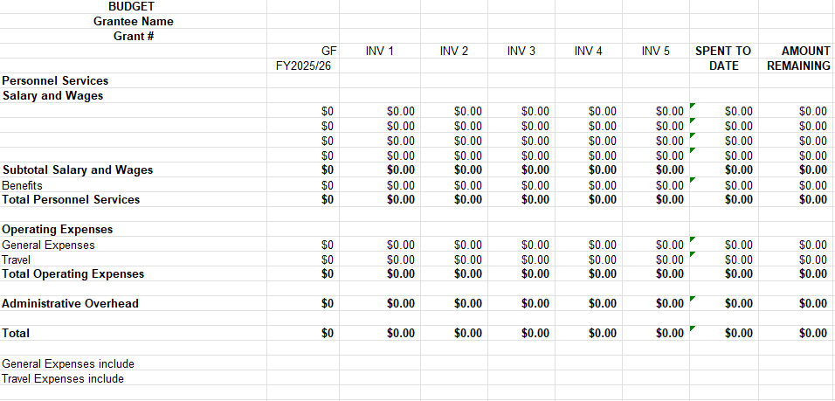
If you want an Excel spreadsheet of your grant budget, email me.
Notes:
The way we track your grant budget is we make a simple Excel spreadsheet and document your invoices and your running total on that spreadsheet.
Your organization may already have software that you will use to track this grant, but if not and you would like us to send you the spreadsheet we’ll be using, please email me.

Slide 11
Grant changes
Changes to your grant need written pre-approval. Please reach out to me as early as possible with change requests.
Notes:
Before we move on from grant agreements, let’s talk about changing your grant agreement. If you need to make changes to any part of the grant agreement, you need to get in touch with me as early as possible. You need prior written approval for changes. Often that approval can be a quick email response, but more substantial changes may require signatures.

Slide 12
Extending Grant End Date
If you think you need to extend the end date of your grant, let us know ASAP and minimum one month before current grant end date!
If your project begins on or before June 30, 2026, you can’t extend past April 27, 2028.
If your project begins on or after July 1, 2026, you can’t extend past November 30, 2028.
Notes:
We’ll get into smaller changes later, but one change to your agreement that will always require paperwork and time to complete is if you need to extend the end date. If you start to think that you need more time to complete your project, you should let me know as soon as possible, and at the absolute minimum a month before your current grant end date.
For grant agreements that are starting on or before June 30, they can last as long as April 27, 2028. For grant agreements starting on or after July 1, they can last as long as end of November 2028. So if your grant end date is already that far out, we won’t be able to extend it. If it ends sooner than that and you need more time for your project, we’ll ask you to propose a new end date and send us a revised timeline. Then we’ll need to process and sign a new grant agreement showing the amended dates. That process takes time which is why you need to notify us as soon as you realize you’ll need an extension.

Slide 13
Bookmark the Whale Tail Grantees’ webpage:
www.coastal.ca.gov/whaletailgrant/forgrantees.html
Notes:
Let’s set aside the grant agreement for now, and we’ll come back to that again later. This is our Grantee webpage, which contains information about grant management, including resources on invoices, advance payments, reporting, and funding credit. You should bookmark that page for your reference. But if you lose it you can find it on the Whale Tail Grant webpage, which comes up if you google Whale Tail Grant so you should always be able to find that.

Slide 14
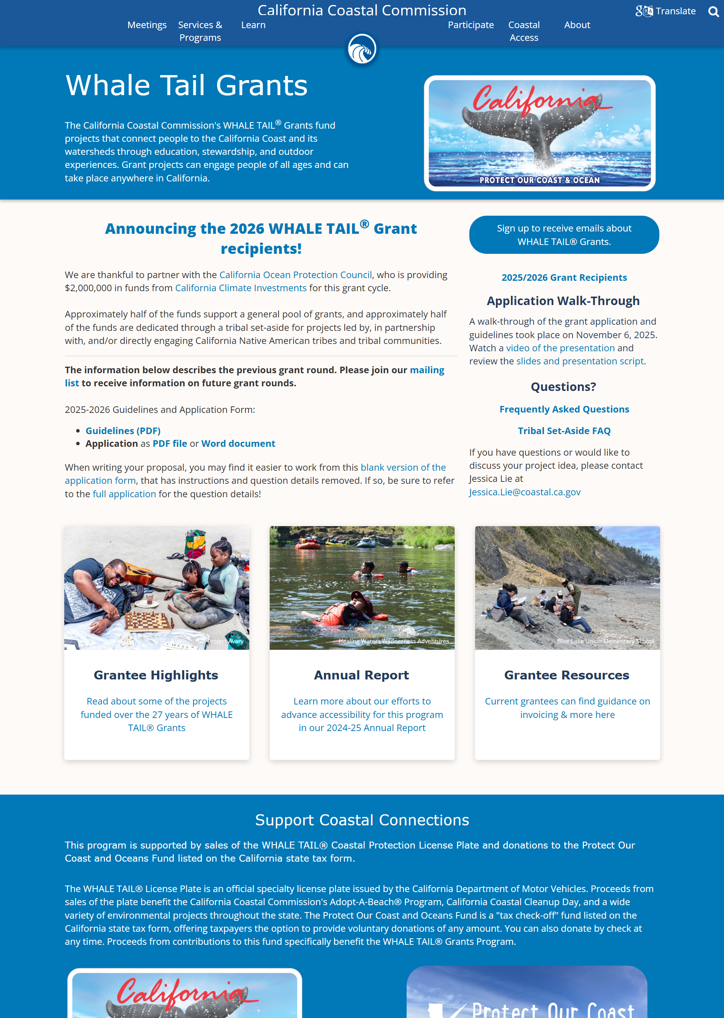
Notes:
(Describe the grant webpage and how to find the For Grantees webpage)

Slide 15
Notes:
(Describe the grant webpage and how to scroll down to find the For Grantees webpage link)

Slide 16
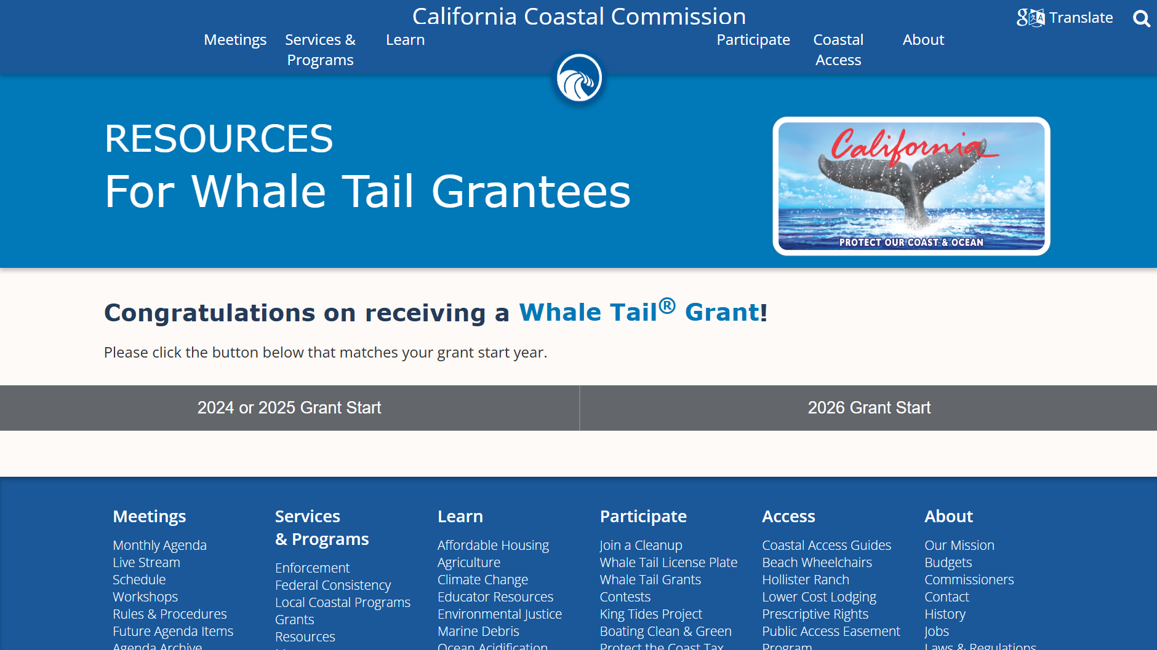
Notes:
(Describe the For Grantees landing page and clicking the “2026 Grant Start Date” button)

Slide 17
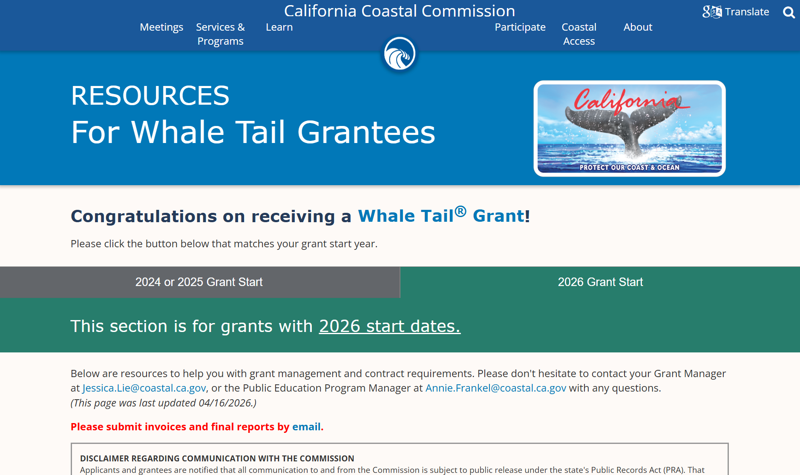
Notes:
Clicking the button will open up your grantee resources and information. As you see in red on the page, we’re handling everything through email. That means you should email me your invoices and your reports. If that presents a problem for you, or you need help with that, please let me know and we can figure it out.

Slide 18
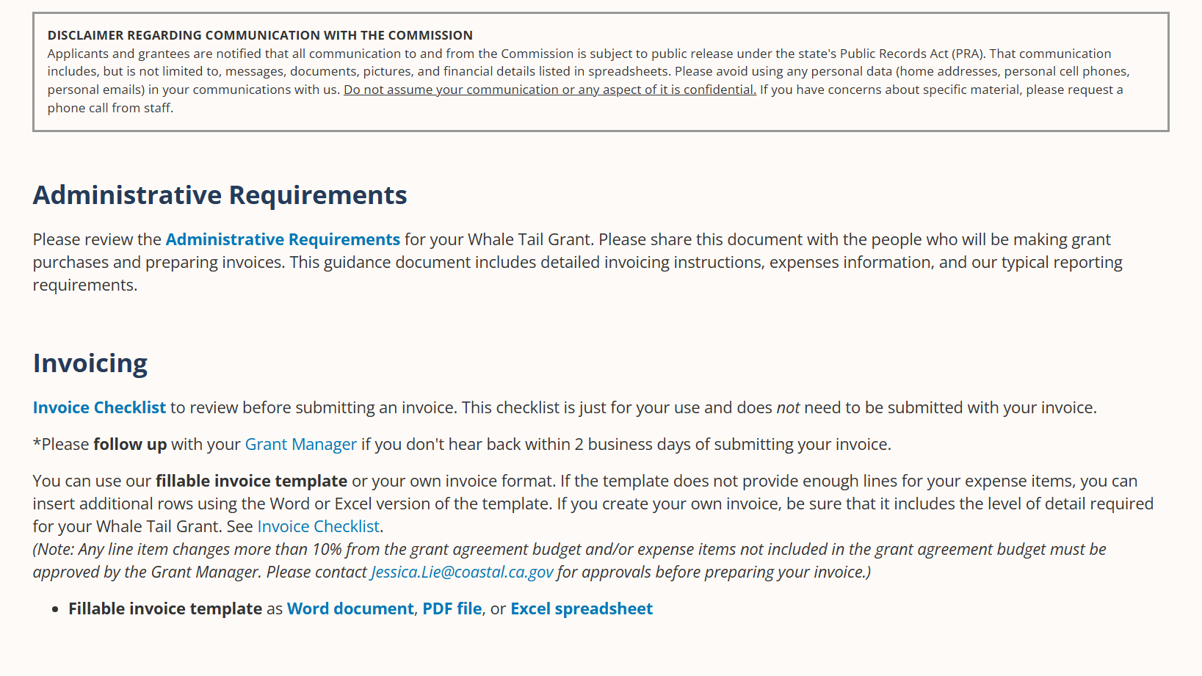
Notes:
As you scroll down the page, you’ll see a disclaimer. As a State agency, we are subject to public release under the state’s Public Records Act, which means you should not assume your communication with us is confidential. Please request a call with me if you have any concerns about this.
We’ve included an Administrative Requirements document that goes over general requirements related to invoicing, advance payments, reporting, and funding credit. Please read through this document, and make sure any other staff involved in the administration of your grant project read it as well.

Slide 19
Grant Agreement
Invoices &
Advance
Payments
Reports
Funding
Credit
Project Delivery
Notes:
Now let’s get into Invoices & Advance Payments

Slide 20
Invoicing
This is primarily a reimbursement grant.
Invoice no more than once per month. Invoicing less often is fine.
Do not submit more than one invoice at a time.
Notes:
This is primarily a reimbursement grant. For many of you, you will invoice for work that you’ve already done, purchases that you’ve already made, or services after the service has been provided.
You can invoice as often as once per month, or less often. Do not submit more than one invoice at a time. Some of you may want to submit just one big invoice at the end of your project. That’s allowed although I do recommend preparing at least one invoice early on so that you can be sure you understand the process and what backup material you need to save.

Slide 21
Invoicing
Grants starting before July 1:
The invoice period of your first invoice must start before the end of June 2026.
You do not have to submit your first invoice by the end of June 2026.
Notes:
Something to note for grants starting before July 1: The Invoice Period of your first invoice needs to start before the end of June 2026. That’s because the end of June is the end of the fiscal year your grant was made in and State government rules say the project has to start within that same fiscal year. You do not have to submit your first invoice by the end June 2026 nor make any purchases before the end of June 2026 – you’re still welcome to submit your first invoice whenever you’d like. Just be sure that the invoice period starts before the end of June 2026 if your grant start date is before July 1.

Slide 22
Before submitting an invoice – review your grant agreement!
Check that expenses fall within your grant term dates and are included in your grant agreement budget
Notes:
Before submitting an invoice, I encourage you to review your grant agreement. As mentioned before, we can only reimburse for expenses that fall within your grant term dates and are included in your grant agreement budget, so it’s helpful to double-check before preparing an invoice.

Slide 23
Notes:
Back to a screenshot of the Grantee Webpage. Under the Invoicing section, you will find invoice resources, including invoice templates.

Slide 24
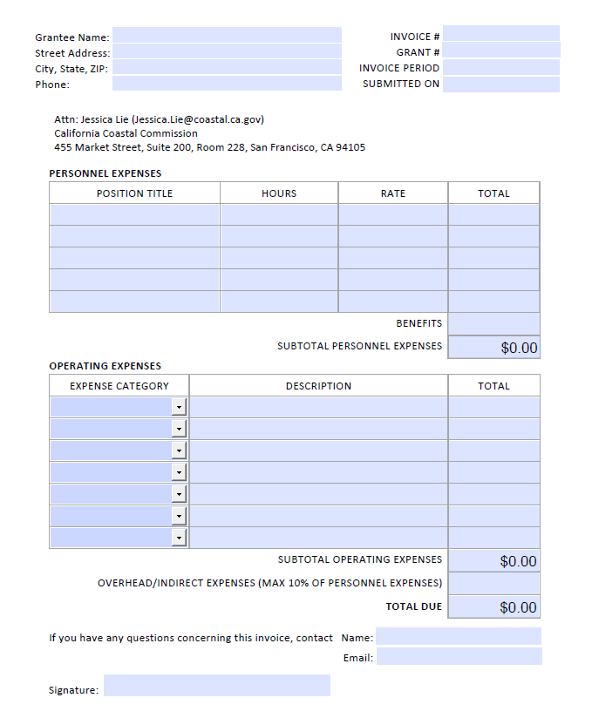
Notes:
This is what the invoice template looks like. You don’t need to use it, you’re welcome to use your organization’s usual invoice template if you prefer, but this shows you the required elements and level of detail we need to see in an invoice.

Slide 25
Assign a unique Invoice Number (such as “2026-01” or “2026-02”; not just “1”, “2”, etc.)
Fiscally sponsored orgs can include identifying info in their Invoice Number (such as “ABC2026-01” for ABC Organization)
Notes:
Let’s zoom into the top section. You always need to include your Grant Number which will be found on your signed grant agreement. If you don’t yet have a signed agreement, you don’t have a grant number yet. Once you do, it will be in the top right corner of every page of your agreement, just under the grantee name. You always need to include an Invoice Period, which is the dates within which the work or purchases included in the invoice took place.
Your invoice needs to have an Invoice Number. Our accounting staff requests that you not use “1,” “2,” etc., but choose a more unique number, such as “2026-01”. That’s because if your organization has had a Whale Tail Grant in the past or gets one in the future, a search in our system for Invoice #1 could bring up multiple invoices rather than the specific one they’re looking for.
Here is a tip specifically for fiscally-sponsored organizations regarding Invoice numbers: Your reimbursement checks will be made out to the Grantee (which is your fiscal sponsor) and mailed to them from the State Controller’s Office. The checks will not have your project’s name on them. If your fiscal sponsor might not know which of their projects received a check from the State Controller’s Office, coordinate with your sponsor on a system for your invoice numbers. The invoice number is noted on the check stub, and it’s the only element that might identify the project. For example, if ABC Org is fiscally sponsored, they could number their invoices as “ABC2026-01,” so that their sponsor would know the reimbursement check is for ABC’s project. So you should talk to your fiscal sponsor about how best to do that.

Slide 26
Include the position title, rate, and hours when invoicing for wages.
Don’t round to the nearest dollar.
Include receipts for all Operating Expenses.
Overhead is max 10% of Personnel Expenses
Notes:
Back to instructions for ALL grantees. Let’s look at the full invoice template again.
If you’re invoicing for wages, for each position you’re invoicing for we need to see the position title, the amount of time, and the rate paid for that position. If there are benefits, you can include that as a lump amount for all positions. This reflects the way personnel is detailed in your grant budget. We don’t need to receive any other backup material for personnel costs, like time statements. You should keep those records in case of a State audit, but you don’t need to send them to me when you invoice.
In your invoice, please do not round up to the nearest dollar. We reimburse to the nearest penny, including when you multiply wage rate times number of hours, so if the math doesn’t come out right, we’ll need to correct it. This is different from what you may see in the budget table in your grant agreement, where we’re required to round to the nearest whole dollar.
For any of the items under Operating Expenses (including General Expenses, Travel, and External Contracts), you do need to include receipts or backup documentation. We’ll get into that in a little bit.
Lastly, if you are invoicing for Overhead/Indirect Expenses, please be sure that it is included in your grant agreement budget. And please be sure that the amount does not exceed 10% of the Personnel Expenses on the invoice. So if this invoice has $100 in Personnel Expenses, the maximum Overhead you could include on the invoice would be $10.

Slide 27
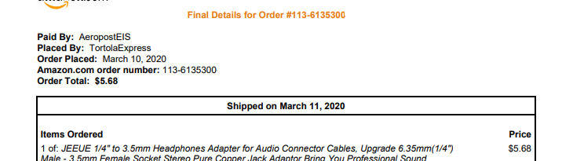
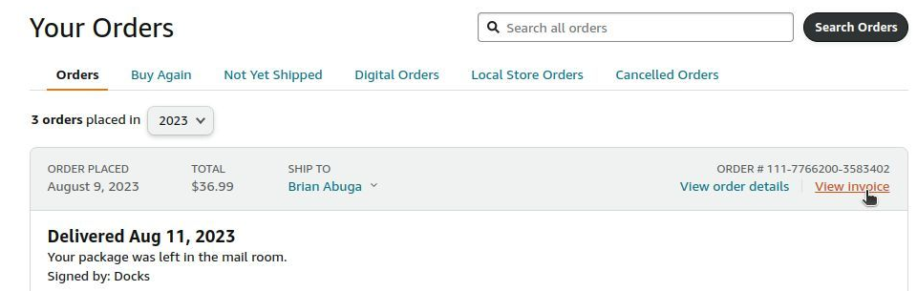
Backup Documentation
We do not need backup documentation for Personnel Expenses or Overhead.
We do need backup documentation for all Operating Expenses. Save your receipts!
For Amazon receipts, be sure to send the receipt that says “Shipped” or “Delivered”
Notes:
Let’s go into what backup documentation is needed with your invoice.
We do not need backup documentation for Personnel Expenses or Overhead with your invoice, but please keep these documents for your own records in the case of a State audit.
Again, we do need backup documentation for all Operating Expenses. So if you buy something, save the receipt and include that as part of your invoice. If you’re not sure what backup material should be for a budget item, get in touch and we can figure it out.
One thing that often comes up with online receipts, specifically Amazon receipts, is that we need you to send the receipt that says the item has shipped or has been delivered. Don’t send the one that just says it was ordered. You have to wait until it ships to invoice for that purchase.

Slide 28
Travel Backup Documentation
For school bus travel, just need the receipt
For mileage or overnight travel, you need to complete and include a Travel Expense Claim form
Notes:
Invoicing for travel can have some additional requirements. If you’re invoicing for hiring a school bus, you can just include the receipt for that. But if you’re invoicing for mileage or overnight travel, there’s an additional form, called a Travel Expense Claim form, that you need to complete and include.

Slide 29
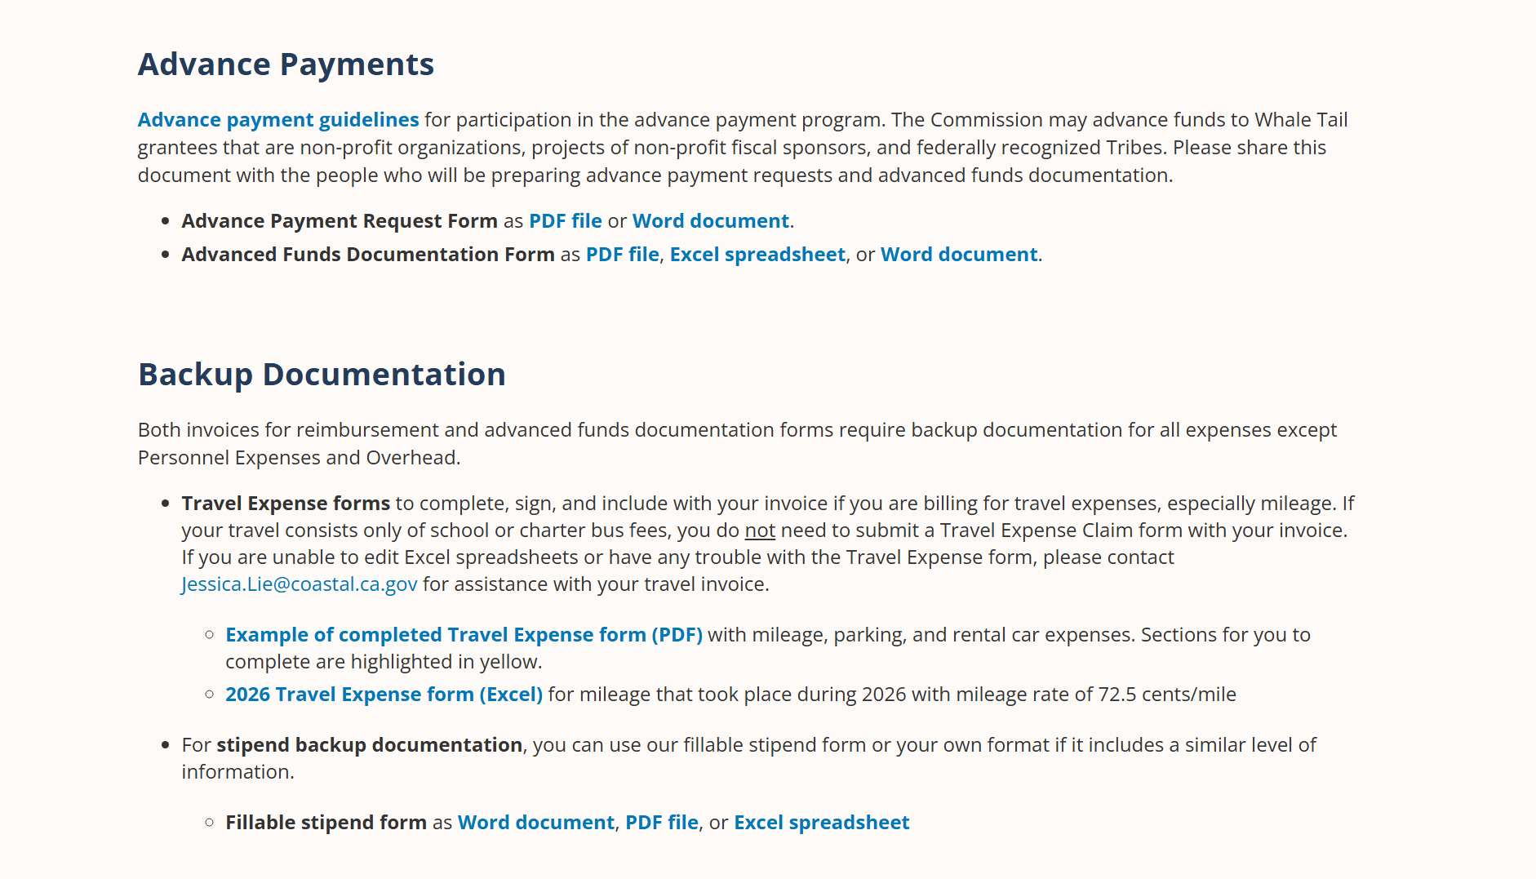
Notes:
You can find the Travel Expense Claim form under the Backup Documentation section by scrolling down on the For Grantees webpage.
As mentioned, the Travel Expense Claim form serves as the backup documentation for any Travel expenses in your budget (except school bus travel).
You can download the Travel Expense Claim form as an Excel spreadsheet. If you’re not able to use Excel and need help, please let us know. On this webpage you can also find an example of what a completed Travel Expense Claim form might look like.

Slide 30
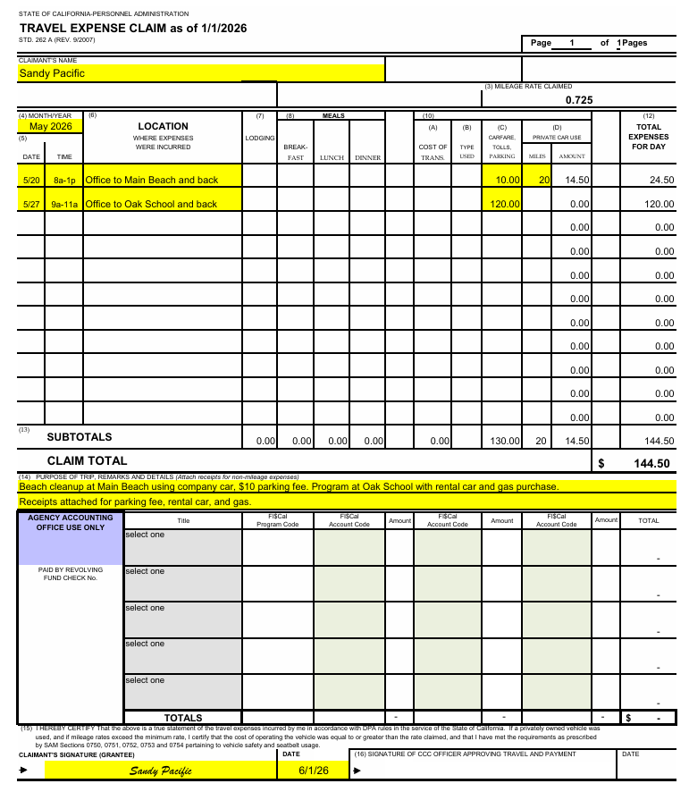
Travel Expense Claim Form Example
Don’t forget to sign and date at the bottom of the form.
For organization-owned or personal vehicle travel, we can only cover mileage. 72.5 cents per mile for 2026 travel.
We cover gas only for rental vehicles.
Notes:
The example shows you the parts that you need to fill out. Please don’t forget the signature and date needed at the bottom of the form.
As mentioned in the Administrative Requirements document, for organization-owned or personal vehicle travel, we can only cover mileage (which includes fuel, maintenance, and all other costs associated with vehicle operation). Mileage is reimbursed at the IRS rate, which is 72.5 cents per mile for 2026 travel.
We can cover gas only when you’re invoicing for a rental vehicle.

Slide 31
Travel Expense Claim Form Example
If you have multiple people who have travel expenses, you are welcome to combine them into one form.
Please contact me if your organization has a mileage tracking form you would like to use in place of this form.
Notes:
If you have multiple people who have travel expenses, you are welcome to combine them into one form and submit the form with the signature of whoever is managing the grant. We are available to help you if you’re confused or have questions when you’re preparing your invoice.
Your organization may already have a form you use to track mileage for your vehicles. If so, please contact me so I can look at what you use to determine if we can accept that in the place of this travel form.

Slide 32
Expense Notes
Read the Administrative Requirements document for travel claim maximums. If your grant includes lodging, please email me for the maximum rates for the location you’re traveling to.
For food listed under General Expenses, no Travel Expense Claim form is needed. Meals are a maximum of $20 per person. Include receipt and note the number of people.
No tips are reimbursed for food in the General Expenses category.
Notes:
In the Administrative Requirements document, you can find the rules about how much we can reimburse for various travel costs. Lodging rates are a bit more complicated, so please contact me in advance of making overnight lodging reservations if that’s included in your budget.
Many of you have food included in your budget that is outside the bounds of overnight travel, which was approved because it is considered essential to the success of your project. In that case, you’ll see those under General Expenses in your grant budget rather than under travel, and you can just include the receipts without completing a Travel Expense Claim form for it. However, you are still limited to the maximum amount allowed for meals, which is $20 per person. You’ll need to note on your invoice how many people the food was for so we can verify you’re within that maximum. You can just write that on the receipt, or you can include that on the invoice coversheet.
When purchasing food as part of the General Expenses category, we are unfortunately not able to pay for tips. I know this is a lot of information, so please feel free to check in with any questions as you prepare your invoices. And refer to the Administrative Requirements document as needed.

Slide 33
Notes:
For those of you with stipends as part of your grant budget, *we have stipend forms you can use also in the Backup Documentation section on our Grantees page.

Slide 34
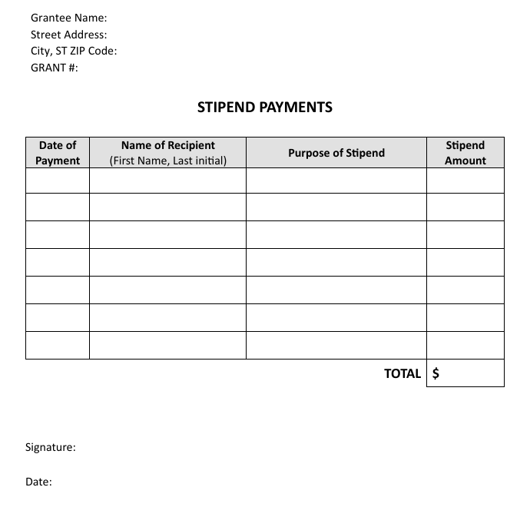
Stipends Documentation
We need backup documentation for stipends.
You can use our form or your own documentation if it includes a similar level of information.
Notes:
We do need backup documentation for stipends since they fall under General Expenses and not Personnel. You are welcome to use our stipends form or your own documentation if it includes a similar level of information.

Slide 35
Receiving Payment
Your address on the invoice must match address on grant agreement. If your address changes, let me know and you can complete an address change form.
If you don’t get your check in 45 days, let me know!
Exception: invoices submitted late May-June may take longer.
Notes:
You need to include an address on your invoice, which needs to match the Grantee address in your grant agreement, the one in the top box on page 2. Remember, that’s the address the checks are sent to. If that address changes, we have a form that you can complete. That needs to be done before we can process an invoice with a new address. If you’re part of a large entity with multiple addresses, especially if someone else, like an accounting department, is submitting your invoices, please check in with them so they know what address needs to be on the invoice.
The State of California says that you should receive a check within 45 days of us receiving an accurate, complete invoice. In that time it passes through several people’s desks and several offices. The first step is me approving your invoice, and I’ll notify the person who submits your invoice when I’ve approved it. If you don’t hear from me in a few days, feel free to email me again. If you don’t receive your check in 45 days, please let me know. If that happens, we can ask our accounting staff to track the status of your check.
An exception to that is at the end of our fiscal year, when our accounting office and the State Controller’s Office will hold invoices while they are working on closing their books for the year. Invoices submitted in late May and June may not be paid until later in July. This also applies to Advance Payment Requests. Please keep that in mind.

Slide 36
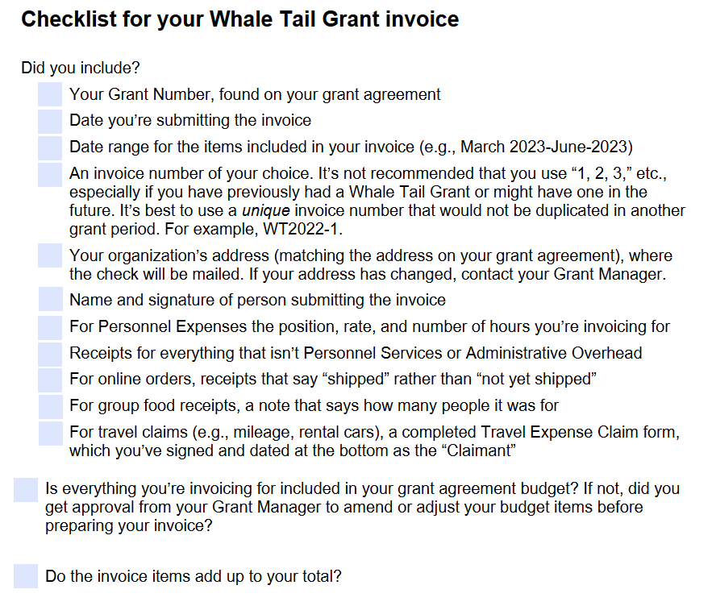
Notes:
Also on the Grantee webpage is an Invoice Checklist. This is just for your use if you find it helpful. It lists the required items I’ve mentioned, and includes reminders like checking your math.

Slide 37
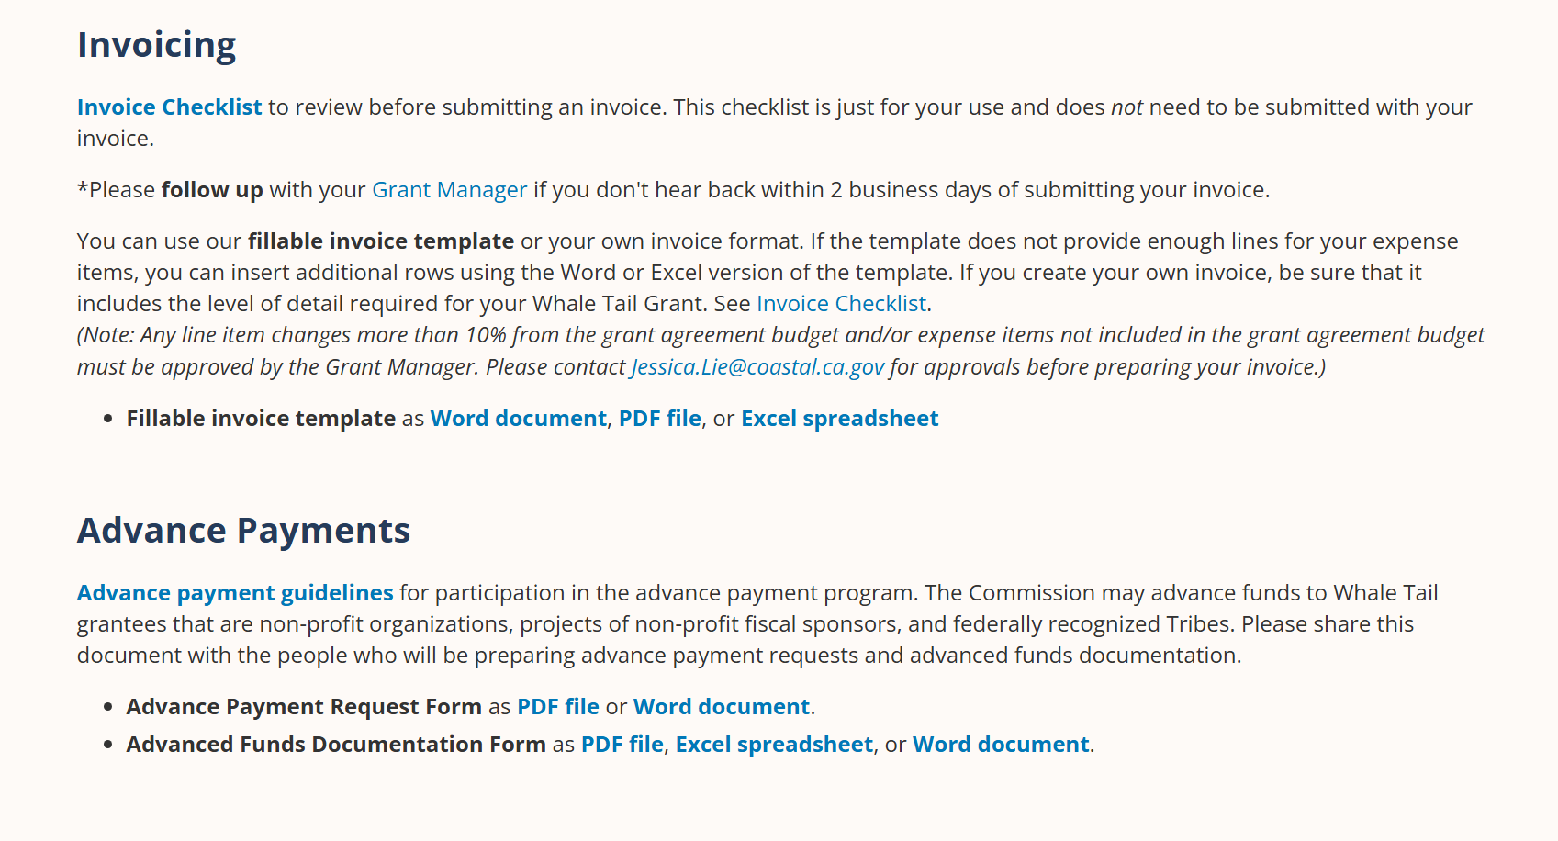
Notes:
Back to Grantee Webpage screenshot. Below the Invoicing section, you can find the Advance Payments section with the guidelines, request form, and documentation form.

Slide 38
Advance Payments
Please read the Advance Payment Guidelines
Available for non-profit organizations, projects of non-profit fiscal sponsors, and federally recognized Tribes
Payments up to 25% at a time, need to spend 100% of payment before requesting the next payment
Cannot have the last 25% of grant funds advanced (invoice for reimbursement)
Pilot year for advance payments, so please reach out with any questions and feedback!
Notes:
Not all of you are eligible for Advance Payments or plan on requesting Advance Payments, so I’ll go over Advance Payments quickly.
Please refer to the Advance Payment Guidelines for full details on eligibility and administrative requirements , and please reach out to me if you have any questions. Advance payments are available for non-profit organizations, projects of non-profit fiscal sponsors, and federally recognized Tribes
One important thing from the guidelines that I’ll note is that you can request a maximum 25% of total grant funds at a time. You will also need to spend 100% of a payment before requesting the next payment. We’ll go into how to document that in a little bit. The last 25% of grant funds cannot be advanced, so you will need to submit an invoice for any expenses using the last 25% of grant funds.
We’re excited to offer advance payments for our first time. We’re learning right along all of you, so please reach out with any questions or feedback about the process.

Slide 39
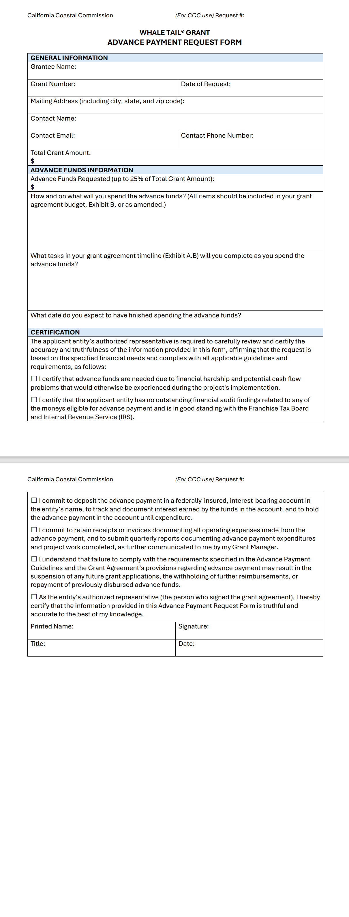
Can submit after your grant start date when you have signed grant agreement
Can take up to 45 days to receive payment
Needs to be signed by the grant agreement signatory
Notes:
Here’s what the Advance Payment Request form looks like. Do not submit an advance payment request until after your grant start date and you have a signed grant agreement. It can take up to 45 days to receive payment after submission, like invoices. This form needs to be signed by the same person who signed the grant agreement

Slide 40
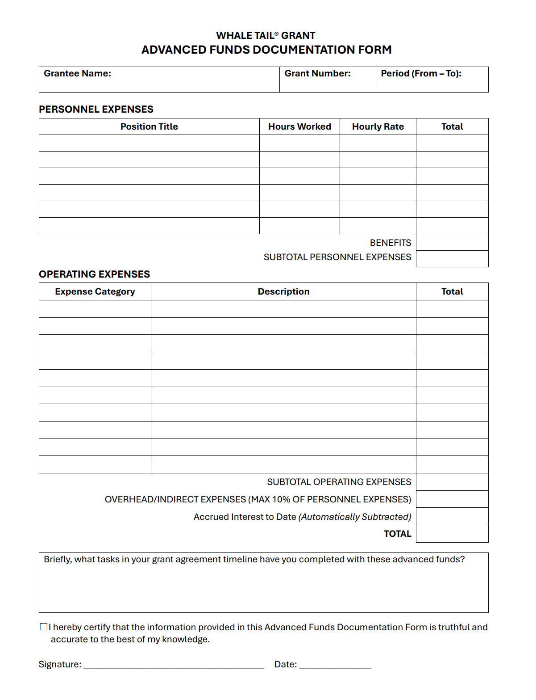
Advanced Funds Documentation
Include bank interest earned on advance payments
Include tasks in your grant agreement timeline that were completed with the advanced funds
Include same backup documentation as invoices
Submit quarterly with progress reports
Notes:
The Advanced Funds Documentation form is what you will complete to show how you spent the advanced funds. We will reference these forms to see if you have spent down 100% of an advance payment and are eligible to request another payment. This form is similar to invoicing but with some additional information needed.
You will need to include the bank interest earned on the advance payments. This will be subtracted from your total for our tracking purposes. Refer to the Advance Payment Guidelines for more details on the requirements for depositing your advanced funds.
You will need to include the tasks in your grant agreement timeline that you completed with the advanced funds. You will also need to include the same backup documentation that’s required for invoices. And you will need to submit this documentation quarterly along with progress reports while you have advanced funds that have not been spent. We’ll get more into that quarterly schedule when we talk about progress reports.

Slide 41
Grant Budget Changes
Changes to your grant need written pre-approval. Please reach out to me with change requests.
Budget line item changes that are 10% or less do not need pre-approval.
Notes:
Again, if you need to make changes to any part of the grant agreement, you need to get in touch with me as early as possible. You need prior written approval for changes, including grant budget changes such as adding a budget item under General Expenses or shifting funds from Personnel to Travel. Often that approval can be a quick email response, but more substantial changes may require signatures. Please don’t wait to request a change until you’re submitting an invoice. That will delay the processing of your invoice.
Something that doesn’t need prior approval is if a line item in your budget changes 10% or less, as long as you stay within your total grant budget. This includes changes to the rate of pay for a position in the budget. We do have to consider the pay rates when we’re evaluating grant proposals and the understanding is that they reflect the reality of what staff will be paid.

Slide 42
Grant Agreement
Invoices &
Advance
Payments
Reports
Funding
Credit
Project Delivery
Notes:
Now let’s get into the Reporting requirements for your grant.

Slide 43
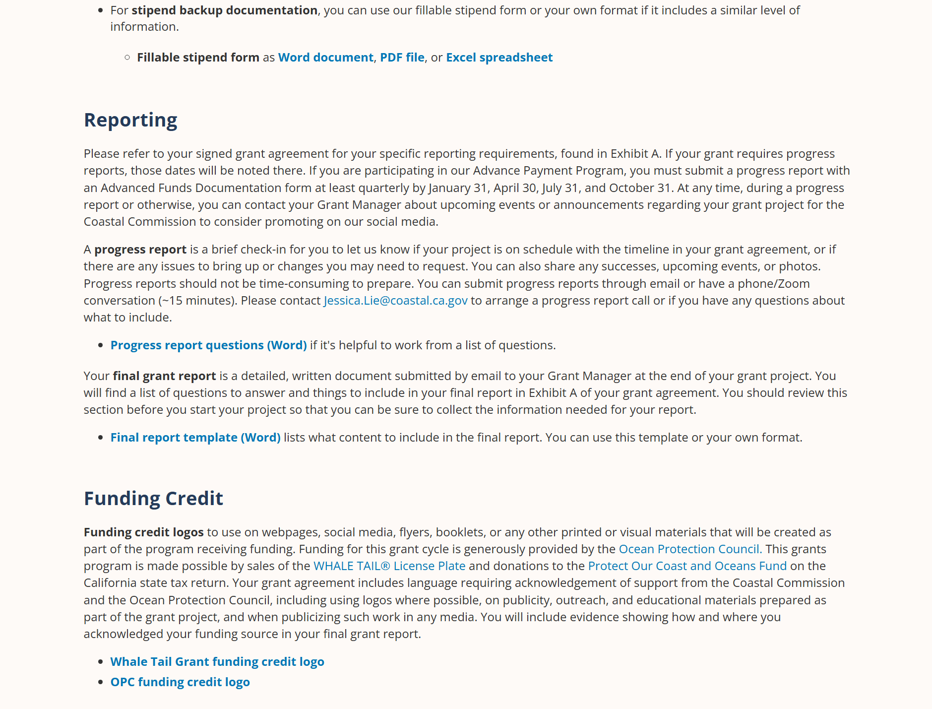
Notes:
Back to the Grantee webpage. This is a screenshot that shows the page scrolled farther down to the *Reporting section with more details and resources for both progress reports and your final report.

Slide 44
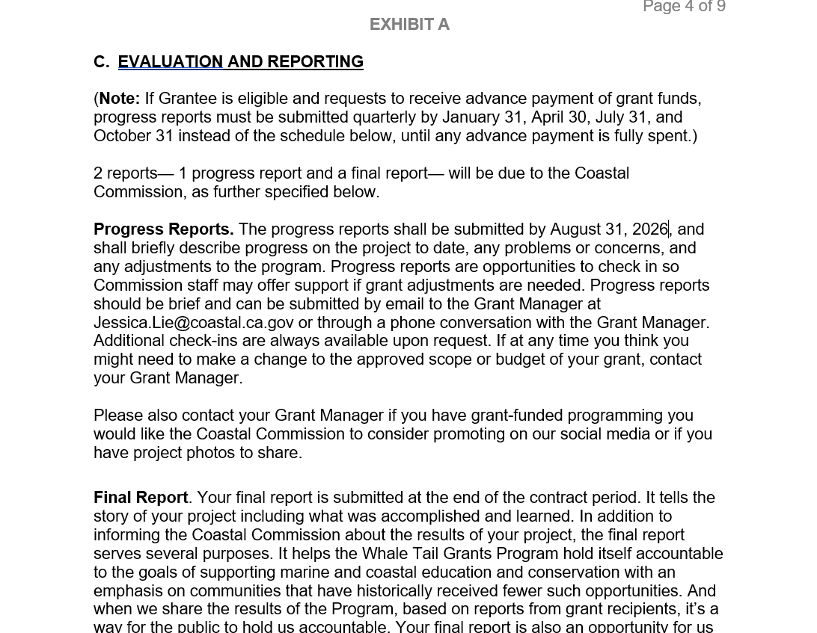
Notes:
Your grant agreement includes detailed instructions on reporting requirements, including progress reports. If you have a short grant period, you might not have any progress reports. If you do have them, it will tell you the date or dates they’re due. We’ll send reminder emails a couple of weeks before your reports are due, but it’s your responsibility to keep track of your own due dates. Progress reports are not meant to be a burden. They can be fairly short.

Slide 45
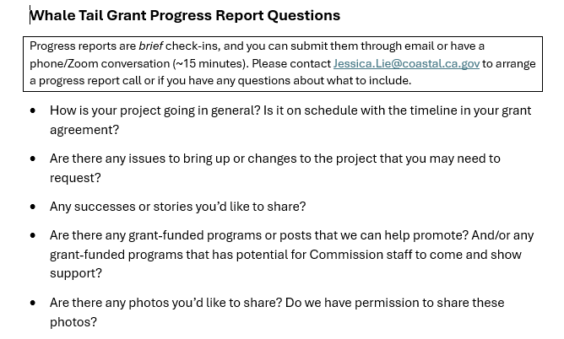
Progress Reports
Notes:
We have a list of progress report questions in a word document on our For Grantees page if that’s helpful to work from. They can be a document attached to an email, or they can just be in the body of an email. If you prefer, you can make an appointment for a phone call and you can do your progress report as a short conversation. It’s a chance to say if things are on track or if any issues have come up. How are things going and how do you expect them to go as the grant project continues? As I mentioned, if at any time you think you need to make changes to what’s in your grant agreement you need to contact me for pre-approval, but this is a scheduled time to do that if necessary.

Slide 46
Notes:
Back to the reporting section in your grant agreement.
As you see at the top of this section, there is a different progress reporting schedule if you request advance payments. This schedule replaces the schedule below while you have advanced funds. As mentioned previously, you will need to submit Advanced Funds documentation along with these quarterly progress reports. The 2nd page of the Advanced Funds Documentation (or 2nd tab if using the Excel version) includes the progress report questions and areas to type in your answers. This schedule is likely to be more frequent than the schedule assigned in your grant agreement, so please take special note if you plan requesting advance payments to track these quarterly deadlines.

Slide 47
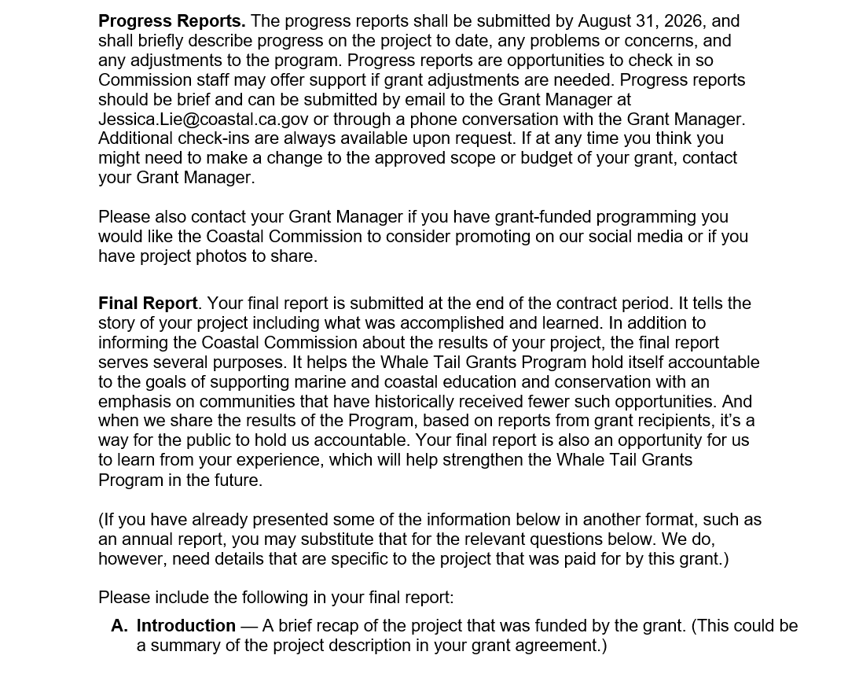
Notes:
Every Whale Tail Grant recipient is required to submit a final report. This is an opportunity to hold you accountable to your commitments as part of this grant program, but it’s also an opportunity to hold the Whale Tail Grant Program accountable to its goals and funders. And it’s an opportunity for us to learn from your experiences. What worked, what didn’t, what are your successes that we should be celebrating.

Slide 48
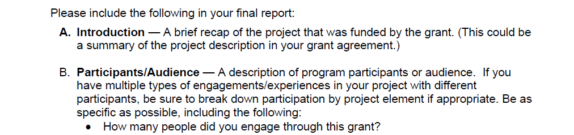
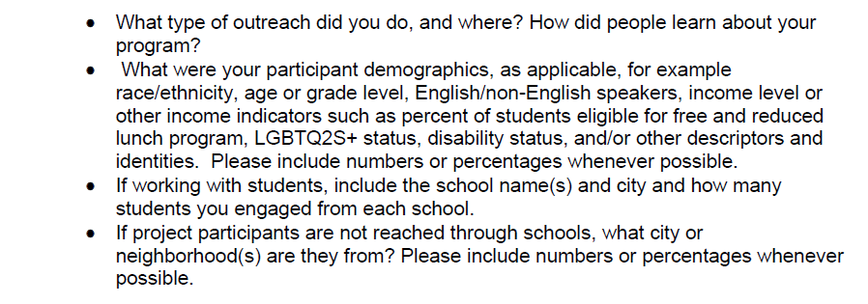
Final Report
Notes:
Reading further down that page of your grant agreement, here is where you’ll find a list of what to include in your final report, although depending on your particular project, not everything here may be relevant. If you’d like to work from a Word document of these questions, you can download that from the Grantee webpage.

Slide 49
Final Report
Who did you engage with your project?
Before you start your project, plan how you will sensitively and respectfully collect this information.
CA Department of Education school data is at
ed-data.org and sarconline.org
What did you accomplish relative to your project’s goals and objectives?
Notes:
Number 1, we need to know who you engaged with your project. The “who” part of your grant proposal was important to your organization receiving this grant, and documenting who you actually reach as you implement your project is really important too.
You should think about how you will collect this demographic information before you start your project, in a way that’s sensitive and respectful to your participants and I’m sure that many of you have already done that. Often, the easiest way to collect it is when people are signing up to participate, if your program operates like that. For example if you’re running a summer camp, ask for racial and income demographics, and other demographics as applicable, during registration. You can include a decline to respond option, and if it’s helpful you can explain that your funders ask for this information.
One tip I’ll share is that if you’re working with school groups and it’s not possible or appropriate to ask for individual responses, you can extrapolate from the demographics of the school. That is, if you don’t have reason to expect that your participants aren’t representative of the school. The California Department of Education makes school data available online at ed-data.org, and School Accountability Report Cards (SARCs) are searchable on sarconline.org. Another website that posts this information is greatschools.org
We also want to know what you accomplished relative to the goals and objectives you laid out for yourself in your grant proposal. Those goals and objectives are included in the Project Description section of your grant agreement.

Slide 50
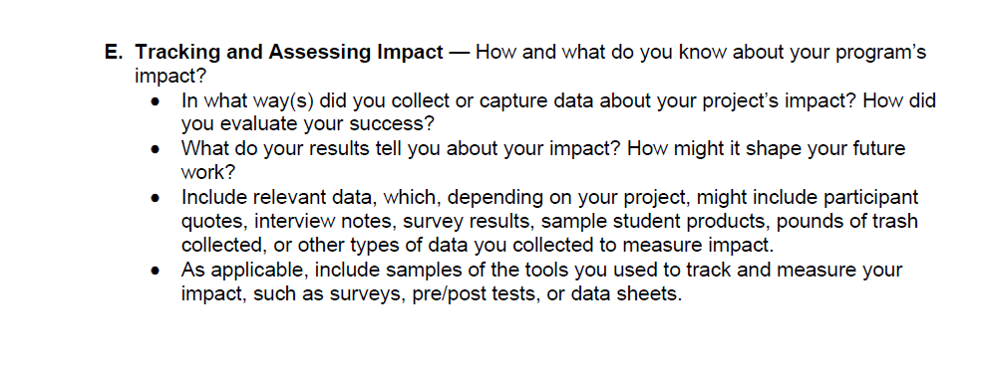
Final Report
Notes:
This slide shows more of the Reporting section of your grant agreement.
We’re interested in how and what you understand about your project’s impact. In your grant proposal you were asked to explain how you would assess your impact, and that is referenced in the Project Description of your grant agreement, so don’t forget to do that as you implement your project. In your final report, include results from any surveys you may have given, or quotes from interviews or feedback forms. If student work was a way you evaluated your program, include some samples of that.

Slide 51
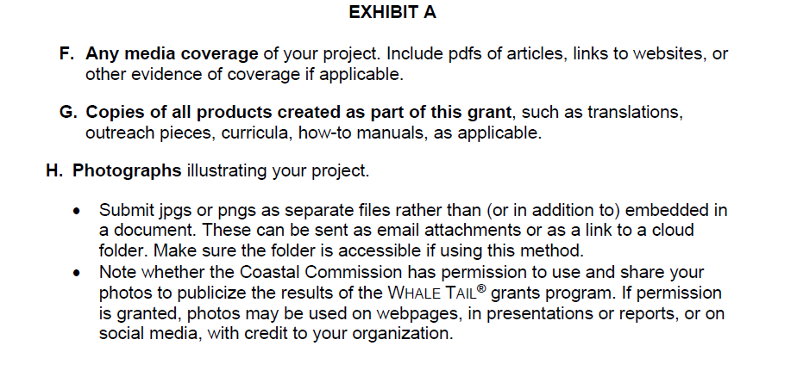
Final Report
Notes:
If you produced a product with the grant, like a curriculum or booklet or sign, we want to see that. If you got media coverage please let us know and include a copy or a link. And please include photos, and let us know if we have permission to share them publicly, which might be on social media or our website or in a presentation. Please attach the image files to your email rather than only including them embedded in a document. It’s also fine to share things with me in a cloud folder, like google drive, but please make sure that I have access to it.

Slide 52
Grant Agreement
Invoices &
Advance
Payments
Reports
Funding
Credit
Project Delivery
Notes:
Now let’s get into Funding Credit.

Slide 53
Notes:
Back to the Grantee webpage. This is a screenshot that shows the page scrolled to the bottom.
Your grant agreement includes a requirement to acknowledge your funding source. Here you can download funding credit logos which you can use.

Slide 54
Notes:
Here are what they look like. If you think you might need a different version or different type of file, please let us know.

Slide 55
Funding Credit
You must give credit to the Coastal Commission’s Whale Tail Grant and the Ocean Protection Council on:
  flyers
  email announcements
  social posts
  signs
  booklets
Notes:
It’s very important to this grant program that you acknowledge both the California Coastal Commission’s Whale Tail Grant and the Ocean Protection Council as funding sources.
If you are promoting the grant project, for example to get people to participate in a program, you should acknowledge the funding. If you create a flyer, or an email announcement, or a social post about the project being funded, acknowledge the funding. If you create a booklet (printed or online) as part of your grant project, credit the funding source in it. If you’re producing something permanent, like signage, you need to reach out for approval before finalizing the sign, and you’ll need to include the funding credit on the sign.
In your final report, we ask you to tell us how and where you recognized the funders. It’s helpful to save screenshots of online acknowledgements to include in your final report.

Slide 56
Applying for future Whale Tail Grants
Whale Tail Grants do not renew.
Funded projects are selected each grant cycle depending on the pool of applicants and the amount of funding available.
Don’t apply for another Whale Tail Grant if you have an active, open Whale Tail Grant.
Read the current guidelines and answer the application questions for the grant cycle you’re applying to.
Notes:
Speaking of funding, I realize that you only just got your Whale Tail Grant and probably aren’t thinking about getting another one yet, but I want to talk about that briefly.
Whale Tail Grants do not renew, and having had a grant does not give you a better chance at being funded the next time. Each grant cycle is new, proposals are looked at fresh, and projects are selected based on the pool of proposals and the amount of funding available during that grant cycle. We don’t accept new grant proposals from organizations with open competitive Whale Tail Grants. So if your current grant end date is still in the future, please don’t submit a proposal for a new Whale Tail Grant until that date has passed and you’ve submitted your final grant report.
If you’re considering applying for a future Whale Tail Grant, be sure to read the grant guidelines and application for that particular grant cycle as rules and questions may change. It’s possible that the deadline for the next grant applications may be earlier or later than it was last year. As of today (5/20/26 or 5/21/26), we do not know what the next grant cycle will look like. You can sign up for the email list on the Whale Tail Grant webpage if you want to be sure of receiving future announcements.

Slide 57
Grant Agreement
Invoices &
Advance
Payments
Reports
Funding
Credit
Project Delivery
Notes:
And finally, we’re at project delivery!

Slide 58
During your project:
Feel free to reach out any time!
Send photos (and note if we can share them)
Invite us to share or attend programs, events
Make a public comment at a Commission hearing or Ocean Protection Council meeting
Notes:
Please reach out at any time during your project if you have any questions or would just like to connect! In addition to including photos in your final report, we love to receive photos at any time during your grant. Let us know if we can share the photos as well. And if you have a grant funded program you want us to consider promoting on our social media, whether it’s after the fact or if it’s an event that we can invite the public to attend (or possibly attend ourselves), please share those with me. We appreciate being able to highlight what Whale Tail Grants are supporting and to help you do outreach for Whale Tail projects when that’s appropriate.
Also, you are welcome and encouraged to speak briefly at one of the Coastal Commission’s monthly public meetings and/or one of the quarterly Ocean Protection Council meetings to feature your grant project. This is a nice way to let the Coastal Commissioners and Ocean Protection Council know about your grant and the good work you’re doing. The meetings are in person and online, so you can speak via zoom if the locations aren’t convenient. If you’re interested in learning more about this, please contact me.

Slide 59



Justice Outside Trainings
If you have not already, please complete a short survey to communicate the topics you’re most interested in by May 22.
Notes:
We’re excited to partner again with Justice Outside to provide free opportunities to our grantees for capacity-building trainings. If you have not already, please complete a short survey to communicate the topics you’re most interested in. The survey will be open until May 22. You can fill out the survey right after this orientation! Based on the survey responses, they will schedule several online sessions available for Whale Tail Grantees, which will include small stipends to participating organizations. These are examples of the trainings from last year.

Slide 60
Tips from Past Grantees
Look at the requested information to be included for the final report to make sure you have collected this information prior to writing the report.
Really plan your budget and keep accurate receipts.
Create a Grant Management Plan to help you and your team stay on top of deadlines for submitting reports and invoices.
Set up a system that tracks and assesses your grant budget usage in real time alongside your targets such as attendance and participant feedback.
Notes:
Lastly for this presentation, I want to share some advice and tips from previous grantees. (Read through the tips)

Slide 61
Tips from Past Grantees
Track invoices and reports throughout the year as you go so it doesn’t pile up at the end!
Ensure you have one point-person on your team who is in charge of tracking deliverables, invoicing, etc. But also make sure that the whole team is on the same page about what needs to be accomplished, what is being funded by the grant, etc.
Attend all the meetings and seminars if you can, they are very helpful and informative!
Notes:
(Read through the tips)

Slide 62
Tips from Past Grantees
The directions are very clear, follow them and read everything thoroughly for a smooth process. If you make a mistake or have a question, do not be scared to ask, they are extremely helpful and want to make sure we are successful.
Everyone is super helpful and friendly. If you have questions, don't be afraid to ask.
Staff are available if you have questions or concerns.
Notes:
(Read through the tips.) Again, if you take nothing else away from this meeting, I want you to know that you can contact us at any time with questions or for help with managing your grant. And you can always refer to the For Grantees webpage for resources as well.

Slide 63
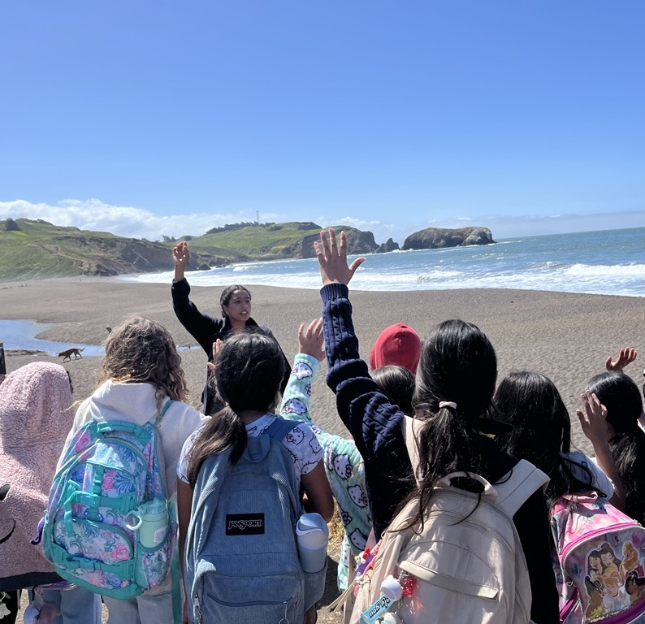
Questions?
KIDS for the BAY
Please reach out at any time:
Jessica.Lie@coastal.ca.gov
Photo: Canal Alliance
Notes:
Thanks so much for your attention during the presentation. Now we have some time for Q&A!

